Slide 1
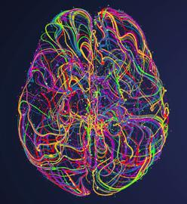



EDUCATIONAL COURSE: Machine Learning for Neuroimaging (ML4NI)
How Do We Test Our Hypotheses?
A Bayesian Approach
Emanuele Olivetti
olivetti@fbk.eu
NeuroInformatics Lab (NILab)
Fondazione Bruno Kessler (FBK), Trento, Italy
Centre for Mind/Brain Sciences, Univ. of Trento, Italy
OHBM2020 Annual Meeting

Slide 2
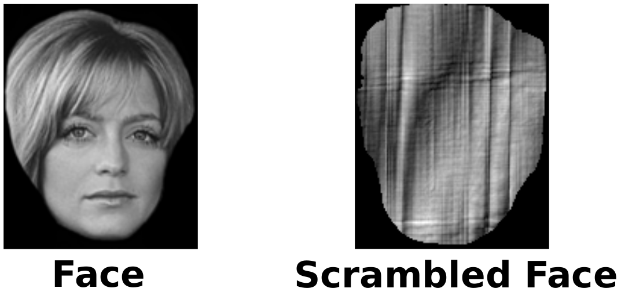
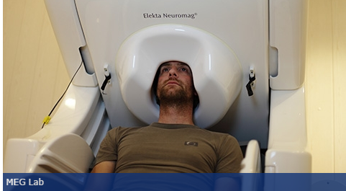
Motivating Example: can we decode Faces?
ARTIFICIAL
NATURE
FOOTBALL
MR.BEAN

Slide 3
Testing Hypotheses
Is there information about [mental process] within brain data? H₁: yes there is information H₂: there is no information
Is it possible to decode stimuli from brain data? H₁: yes, decoding works H₂: no, decoding does not work
Can my classifier discriminate the category of the stimulus? H₁: yes it can H₂: no it cannot

Slide 4
Overview
Testing Hypotheses
Classical/Frequentist
Significance Testing
Hypothesis Testing
Bayesian
Bayesian Hypothesis Testing (BHT)

Slide 5
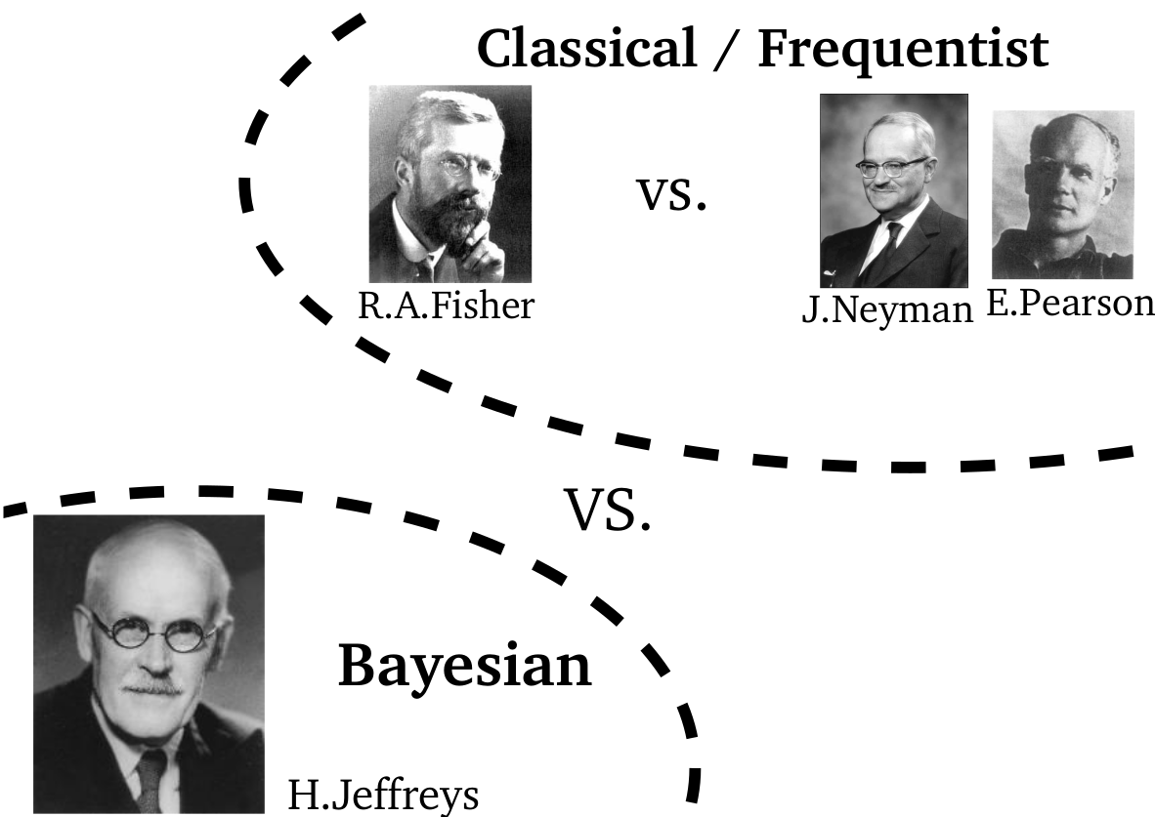
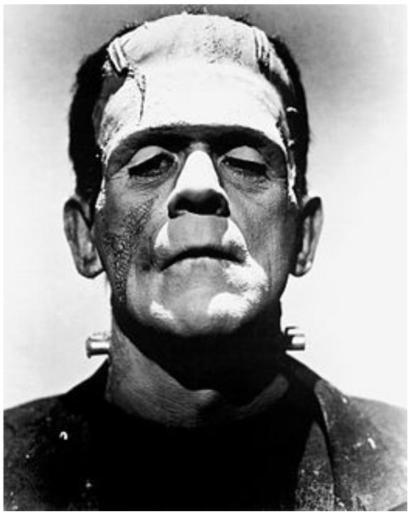
Notes:
"Inference can be defined as the process of deriving logical conclusions from premises known or assumed to be true"

Slide 6
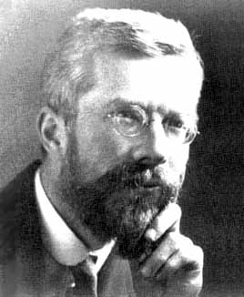
Ronald Aylmer Fisher (1890-1962)

Slide 7
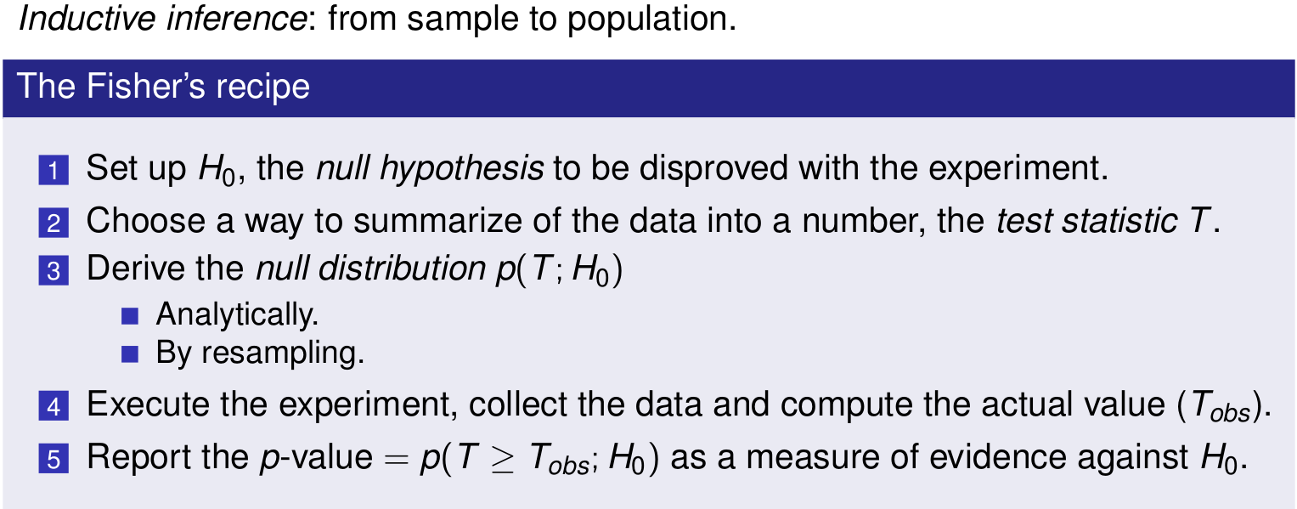
R.A. Fisher: Significance Testing [Fisher, 1955]

Slide 8
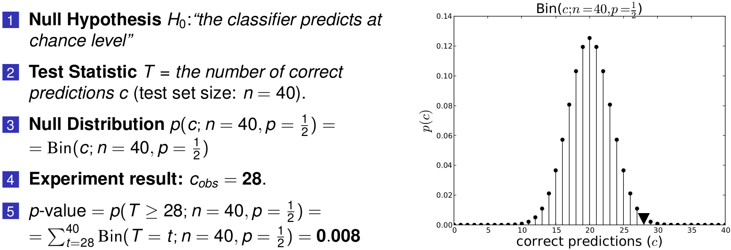
Fisher's Significance Testing: Example

Slide 9
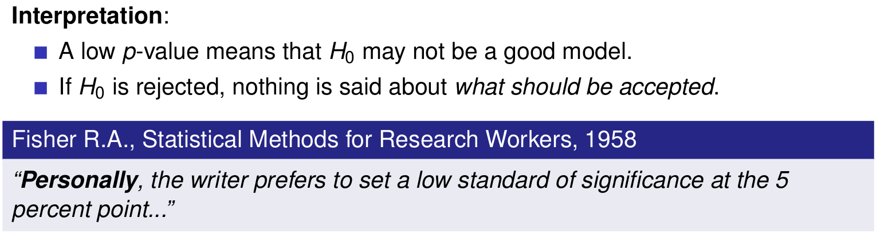
Fisher: Interpretation of the p-value

Slide 10
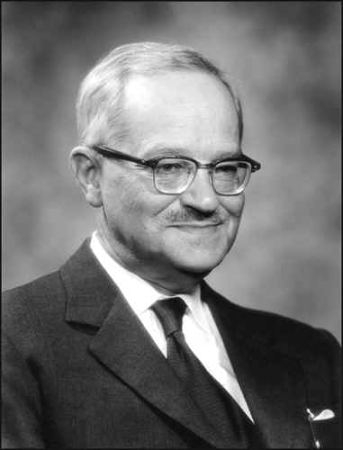
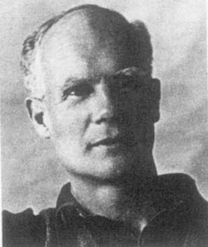
Jerzy Neyman(1894-1981), Egon Pearson(1895-1980)

Slide 11
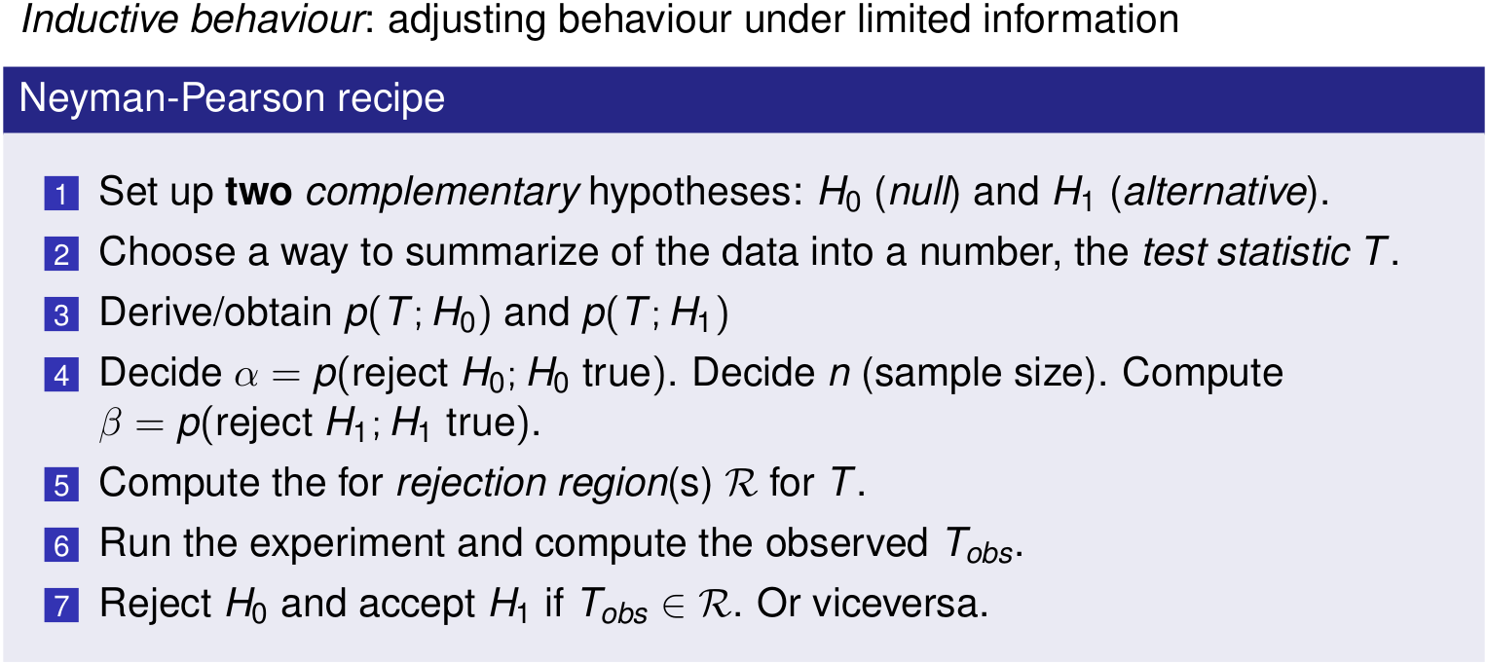
J.Neyman-E.Pearson: Hypothesis Testing
[Neyman and Pearson, 1933, Lehmann and Romano, 2005]

Slide 12
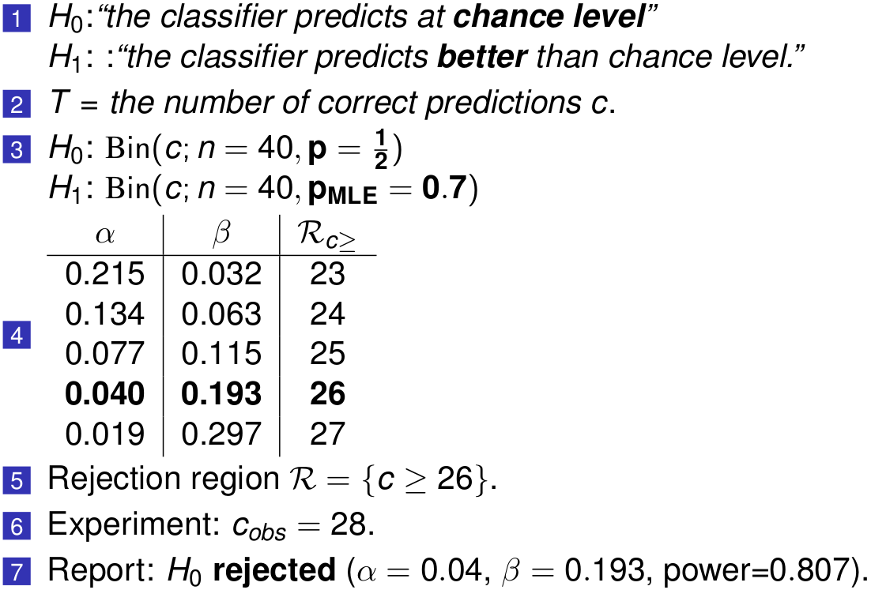
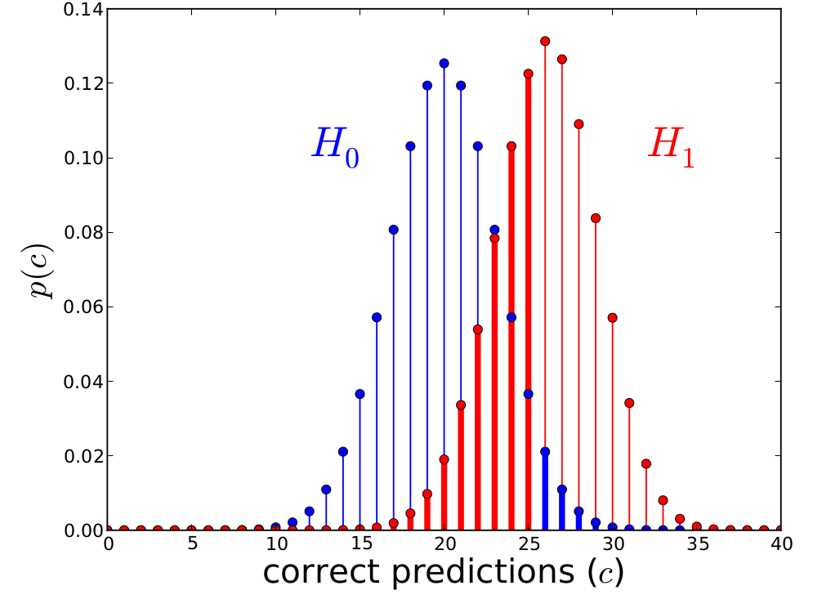
Neyman-Pearson: Example

Slide 13

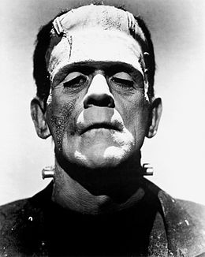
The Anonymous Hybrid (∼1950- today )

Slide 14
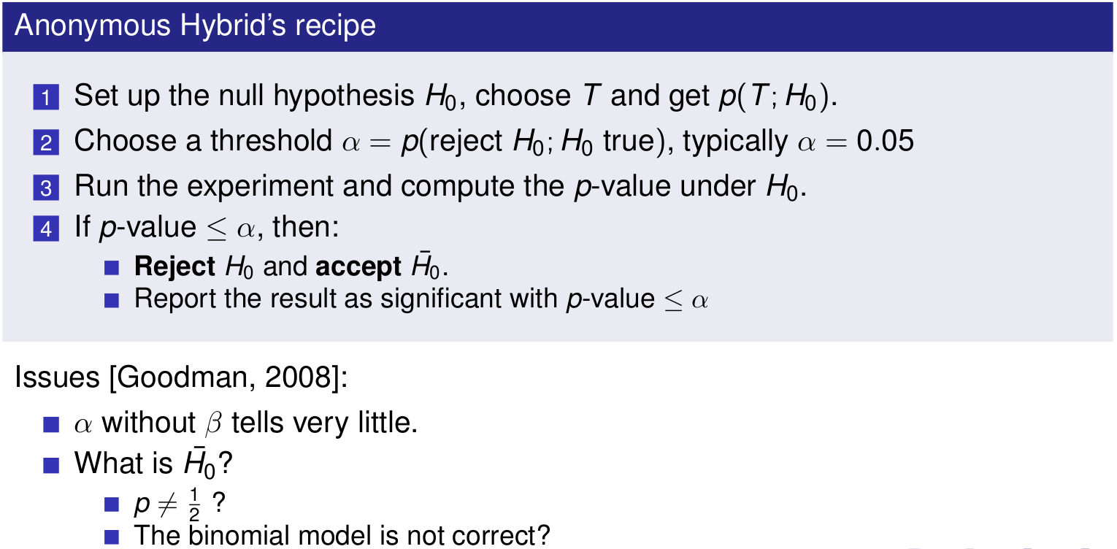
The anonymous hybrid: Fisher + Neyman-Pearson

Slide 15

The anonymous hybrid: Fisher + Neyman-Pearson

Slide 16
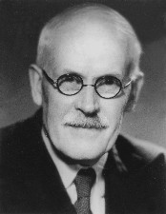
Bayesian Hypothesis Testing
Harold Jeffreys (1891 - 1989)

Slide 17
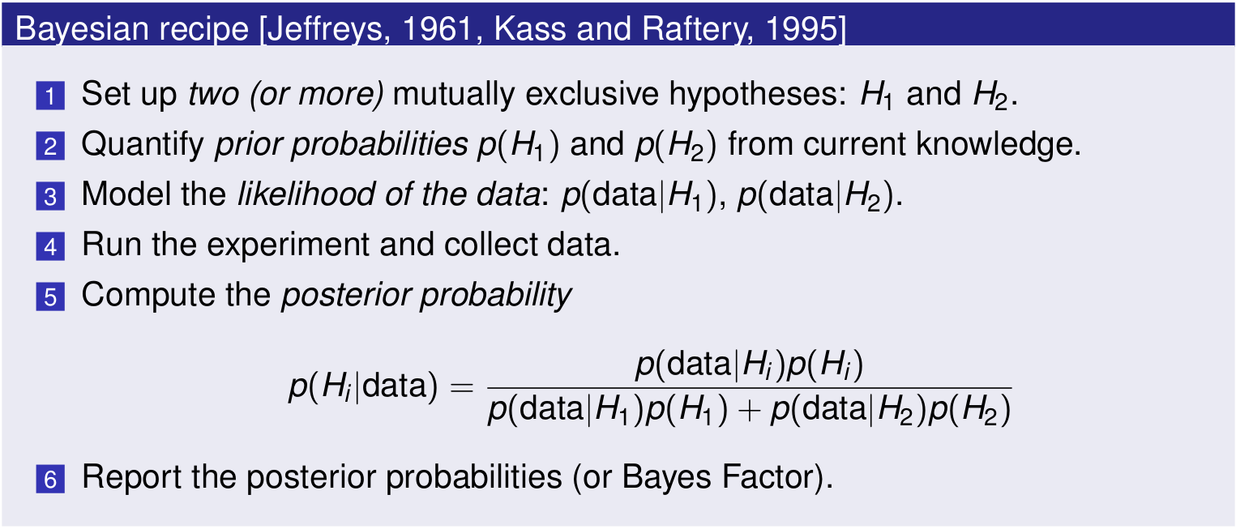
H.Jeffreys: Bayesian Hypothesis Testing

Slide 18
H.Jeffreys: Bayesian Hypothesis Testing
#MATHS
#MATHS

Slide 19
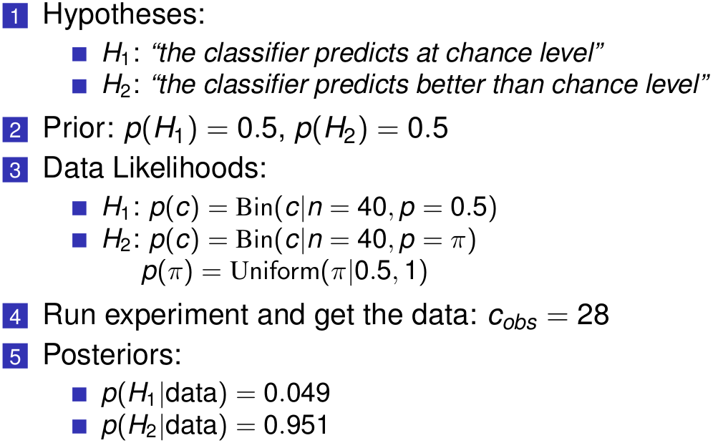
H.Jeffreys: example

Slide 20
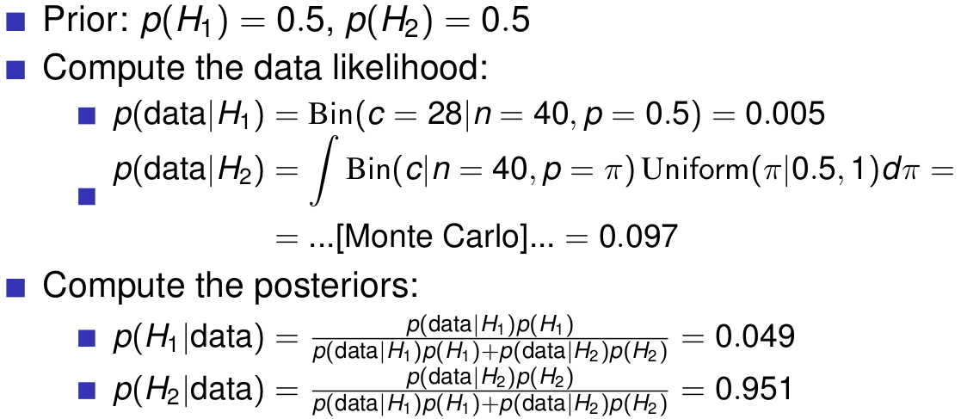
How to compute the posterior probabilities?

Slide 21
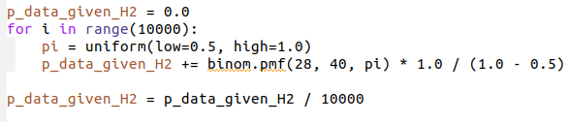
How to compute the posterior probabilities?

Slide 22
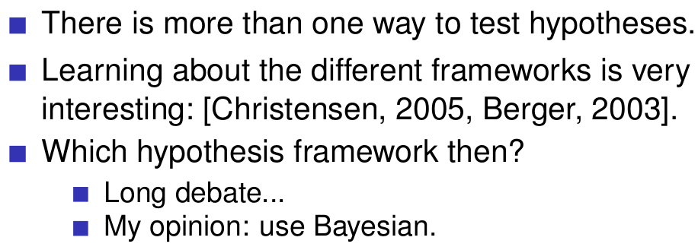
Take-home message

Slide 23
Take-home message
THANK YOU!

Slide 24
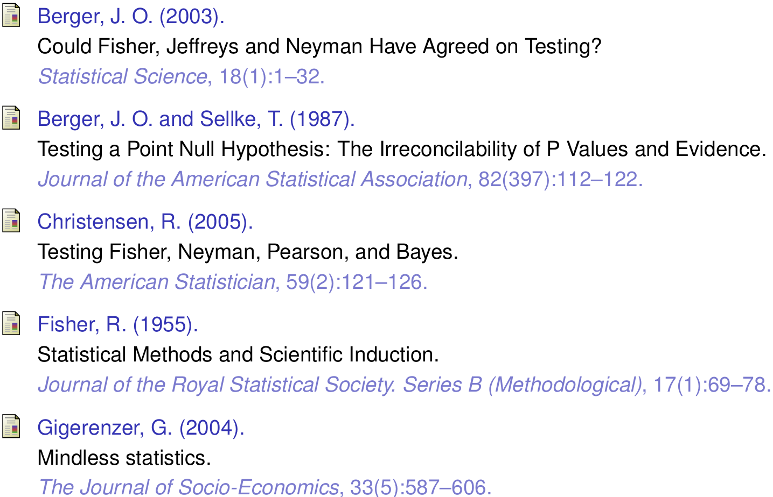

Slide 25
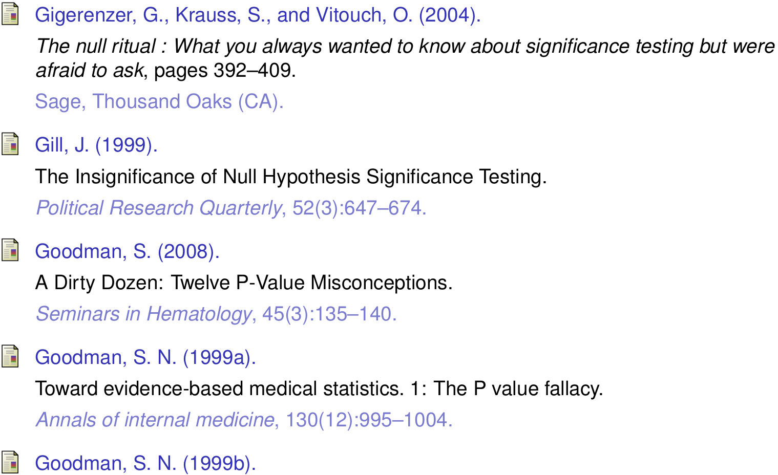

Slide 26
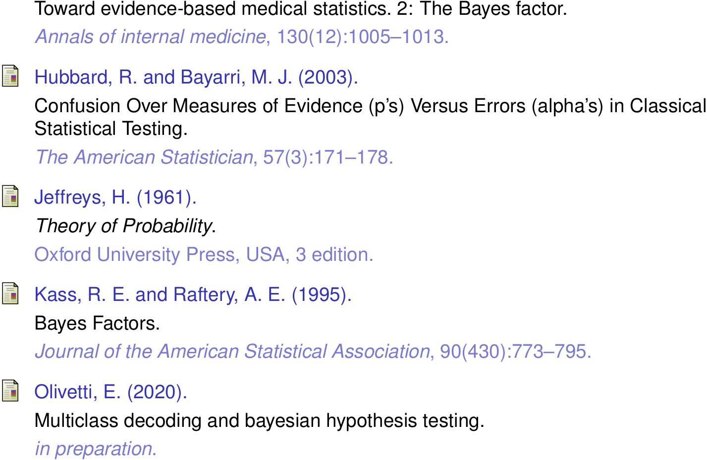

Slide 27
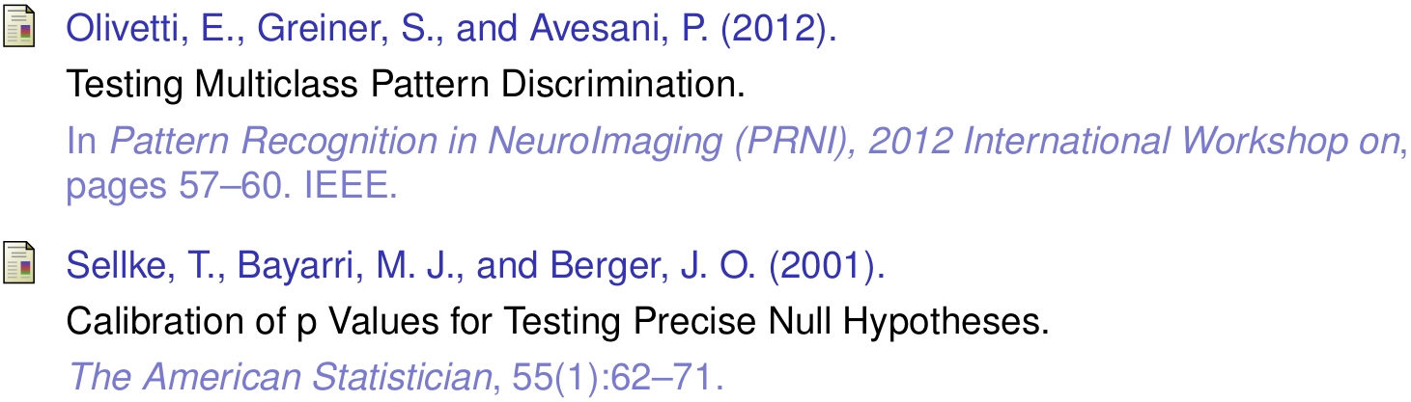

Slide 28
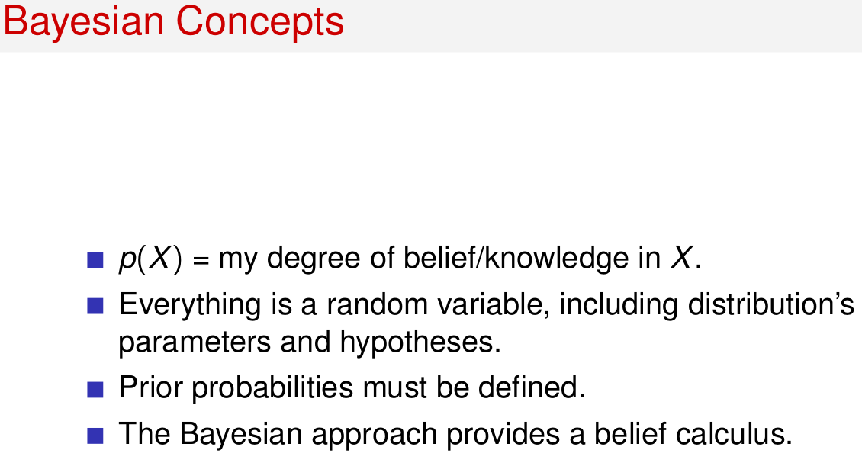

Slide 29
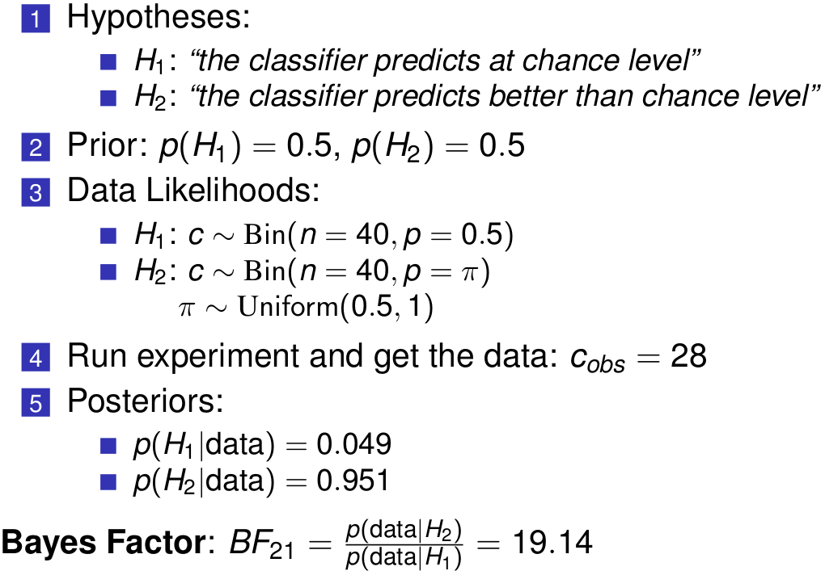
H.Jeffreys: example

Slide 30
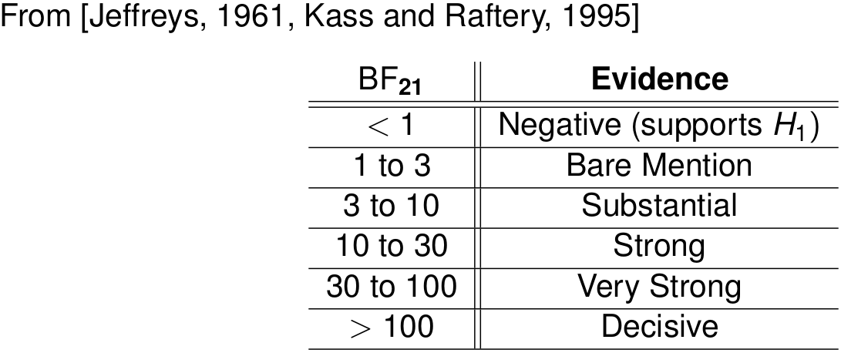
How to interpret the Bayes Factor?
p-value=0.05 ↔ BF₂₁ 2.5-3.4
p-value=0.005 ↔ BF₂₁ 14-26 [Benjamin et al. 2017]

Slide 31


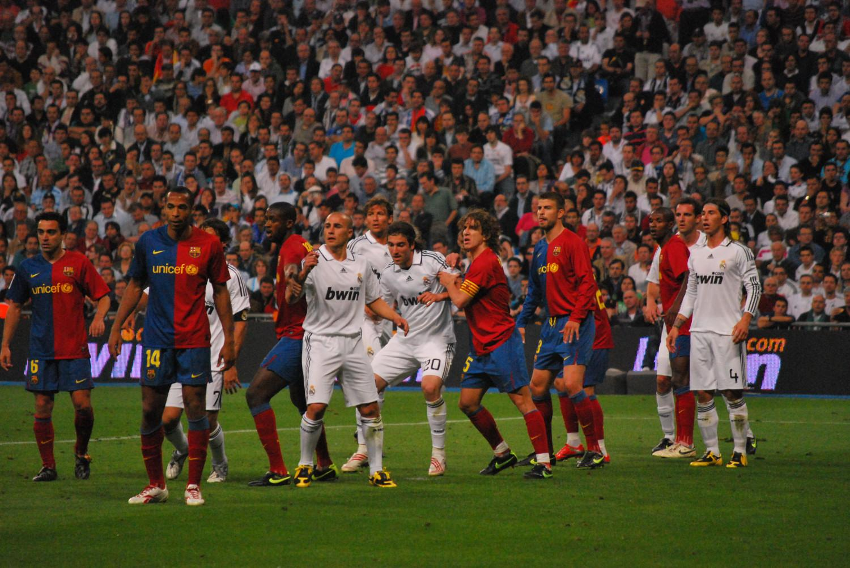

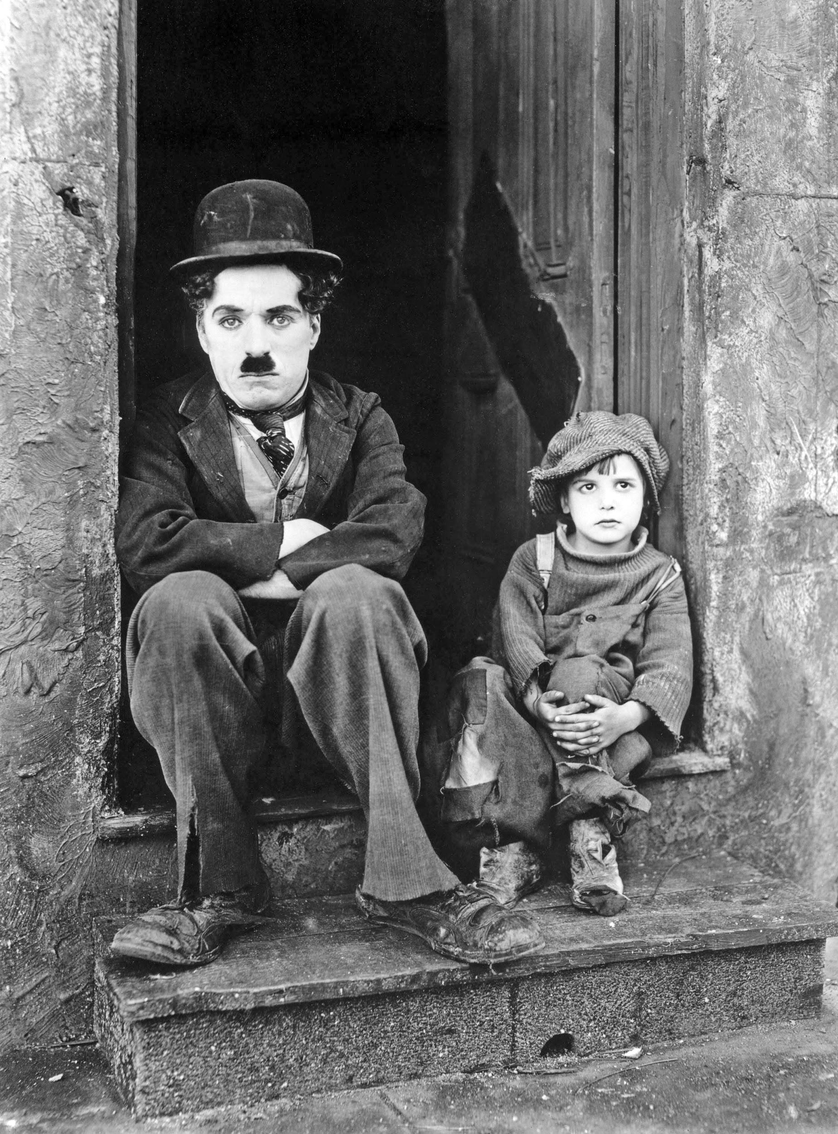
Another Example: can we decode short video-clips from MEG?
ARTIFICIAL
NATURE
FOOTBALL
MR.BEAN
CHAPLIN
[Arto Klami et al. ICANN/PASCAL2 Challenge: MEG Mind Reading]

Slide 32
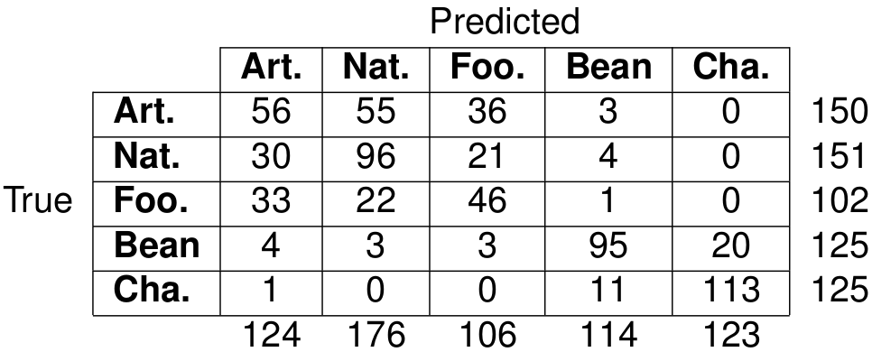
How do we interpret this decoding result?
Q: can the classifier decode all categories of stimulus?

Slide 33
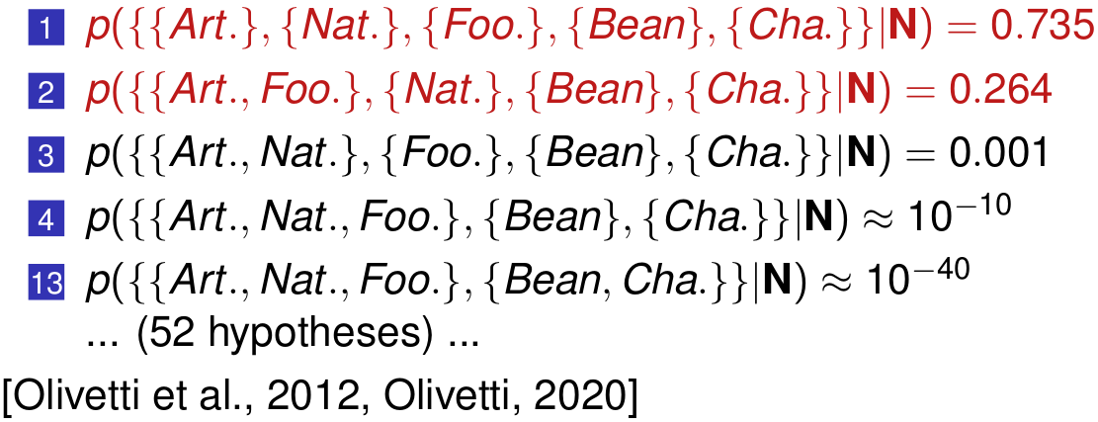
How do we interpret this decoding result?
Bayesian
Hypohesis
Testing

